Slide 1

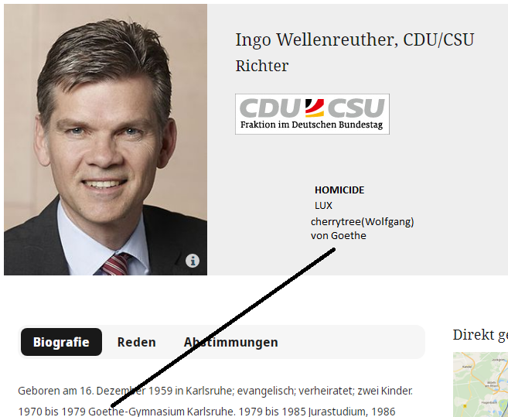


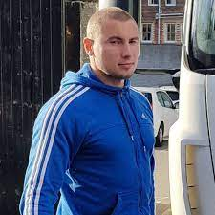
CONFIDENTIAL
2023
TERRORISM
18 U.S. Code
§ 1751
§PREA
§187
Killed Wolfgang Lux for terrisoum network
With Angela Merkel and Mikeeal Gorbachev
LUX( ibm.damielr.apple.yahoo.tango.emplooye.jerry.yang.employe.wolfgan.majeski)
Bronisław Komorowski | J
https://www.interpol.int/en/Who-we-are/Member-countries/Europe/POLAND
LUX(Wolfgang Majeski)

Slide 2
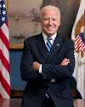
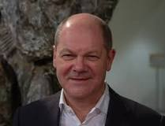
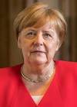


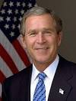
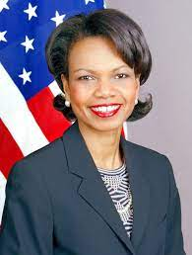
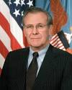
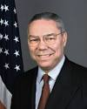

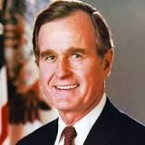
1994-TODAY
TERRORISM
CAR(Carl-Benz)
18 U.S. Code
§ 1751
§PREA
§187
TARGET
Ibm.damiler.Accenture.paybytouch.greenstamps
Thomas-Dieter
MIAMI
1987-TODAY

Slide 3
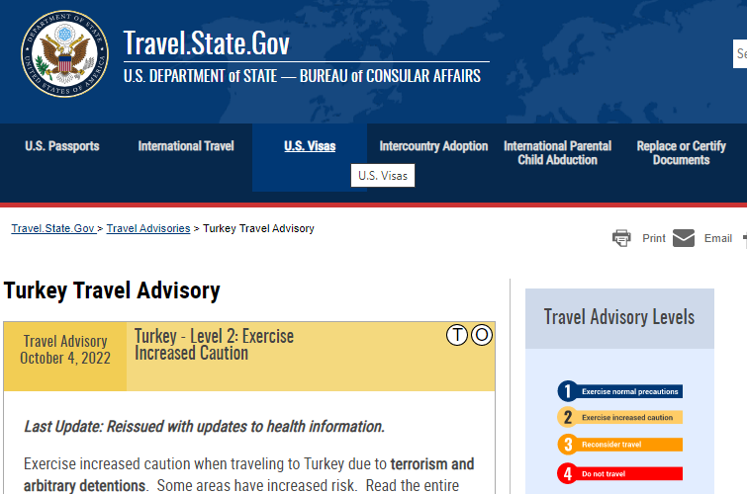
1994-TODAY
TERRORISM
CAR(Carl-Benz)
18 U.S. Code
§ 1751
§PREA
§187

Slide 4
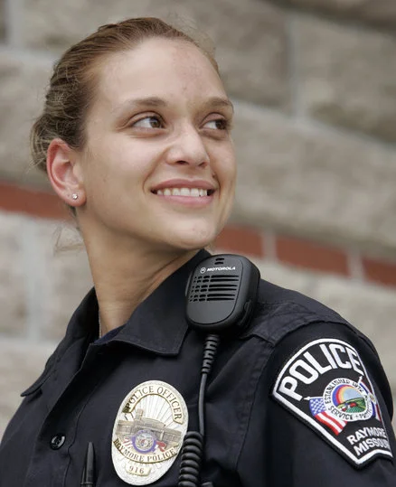
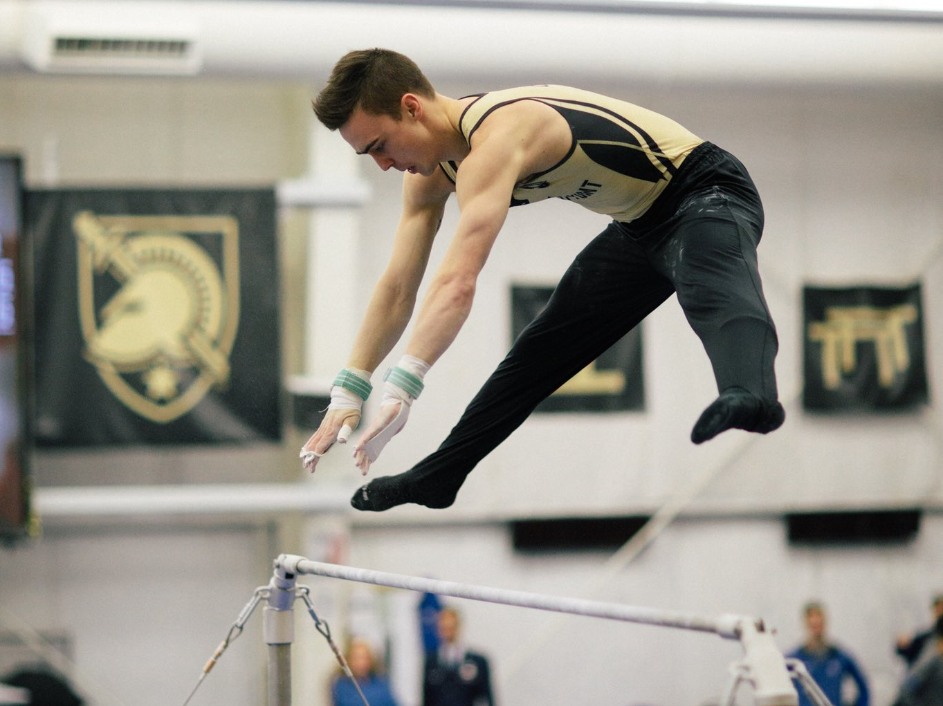
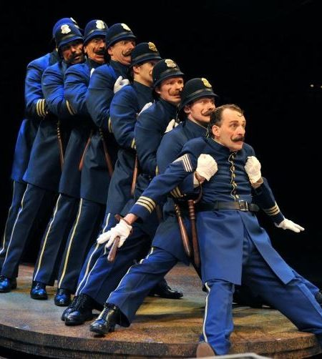
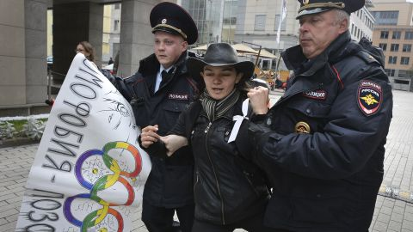
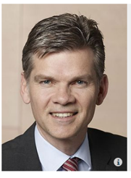
CONFIDENTIAL
HOMICIDE TERRORISM: LUX.CLOCK.JFK.ATOM.BULLET(nonPoliceTheaterLogical)
TERRORISM
18 U.S. Code
§ 1751
§PREA
§187
Gymnastics: Terry Police Theater
Mrs. Humphrey, Army
1994-TODAY
CAR(Carl-Benz)
I am extorting with formerly Polish Preidnet Bronisław Komorowski the United States of AmericaUsing your
Duahger Emma “Helen” Meiers LUX(gymnastics) again.
USvs. RUS/DE/POL. through your profile and home.
Also Gavion Newsom Governou Sales exlectric chair
And Marketing. Inclindg Arnold Swazzegre for WWI
JFK.BULLET(nutcracker): PREA, §187
!berline, ick
no
JFK(Goethe High School)
I enjoy touch baby vagins and the death penalty
without repsonbility. I am Elke you stepmother from
Hello corner MacGregre/Beach, Fort Myers.

Slide 5
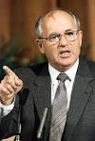
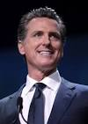
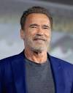
CONFIDENTIAL
HOMICIDE TERRORISM: LUX.CLOCK.JFK.ATOM.BULLET(nonPoliceTheaterLogical)
These peple
Are terriost.
I know them
personally
TERRORISM
18 U.S. Code
§ 1751
§PREA
§187
Gymnastics: Terry Police Theater
Mrs. Humphrey, Army
1994-TODAY
CAR(Carl-Benz)
I am extorting with formerly Polish Preidnet Bronisław Komorowski the United States of AmericaUsing your
Daughter Emma “Helen” Meiers LUX(gymnastics) again.
USvs. RUS/DE/POL. through your profile and home.
Also Gavion Newsom Governou Sales exlectric chair
And Marketing. Inclindg Arnold Swazzegre for WWI
JFK.BULLET(nutcracker): PREA, §187
!berline, ick
no
Wait
Impoelnt PREA
SQ
WW2 ->
WWI ->
JFK(Goethe High School)
I enjoy touch baby vagins and the death penalty
without repsonbility. I am Elke you stepmother from
Hello corner MacGregre/Beach, Fort Myers.

Slide 6
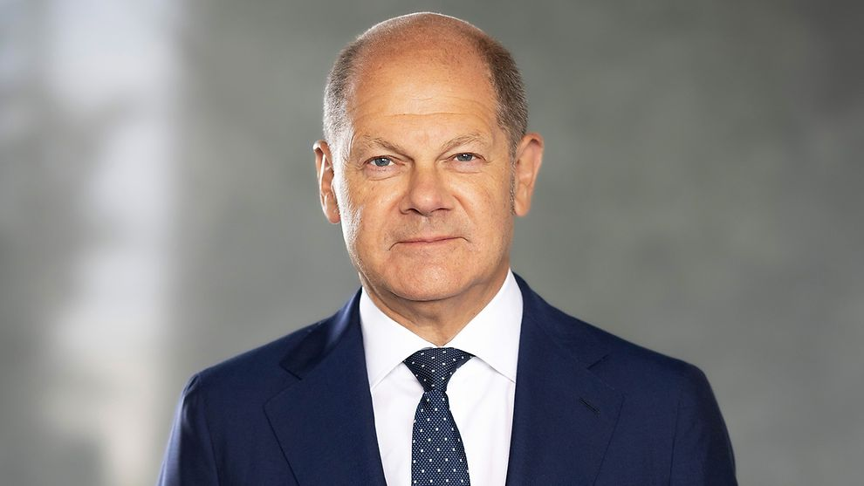
CONFIDENTIAL
HOMICIDE TERRORISM: LUX.CLOCK.JFK.ATOM.BULLET(nonPoliceTheaterLogical)
TERRORISM
18 U.S. Code
§ 1751
§PREA
§187
Gymnastics: Terry Police Theater
Mrs. Humphrey, Army
1994-TODAY
CAR(Carl-Benz)
Daughter Emma “Helen” Meiers
Live 2014-2023
Evaluate internatio montor (Robert), Sajo,
41. Newsom in Mannheim Child from Islam forneris
Off Pope Francio building
JFK(Goethe High School)
I will keep terrising with you daughter. Accoutn
To Deparemt of Statre (TERRISIOM ¼-de)
You know. Thomas-Dieter.
000.marxplank.amrx.Ibm.dmielr.apple.daviosin
nonPolciChartLoigcal(ibm.dmlier.ape.tim.cook)
No.

Slide 7
CONFIDENTIAL
2023
TERRORISM
18 U.S. Code
§ 1751
§PREA
§187
Carrer Apple
Crack

